Slide 1


SPOTIFY
ECOMPREHENSIVE SPOTIFY DATA EXPLORATION AND VISUALIZATION
POWER bi

Slide 2

CONTENTS
About DATA SET
DASHBOARD
OVERVIEW
INSIGHTS
CONCLUSION

Slide 3
ABOUTDATA SET
The Spotify dataset used in this project includes detailed track information such as song titles, artist names, album names, release dates, durations, and popularity scores. Additionally, it features audio attributes like danceability, energy, tempo, and valence, which provide insights into the musical qualities of each track. The dataset encompasses a wide range of tracks from various genres and time periods, offering a comprehensive view of music trends and listener preferences.

Slide 4
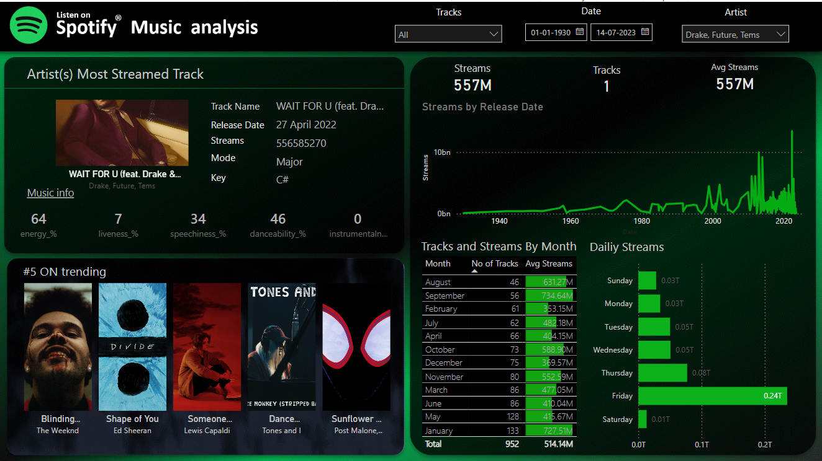
DASHBOARD

Slide 5
Overview
This report provides a comprehensive analysis of Spotify music streaming data, highlighting the most tracks, trends over time, and daily and monthly streaming patterns.

Slide 6
insights
1. Most Streamed Track:
Track: "Blinding Lights" by The Weeknd
Streams: 370,389,0574
Release Date: November 29, 2019
Musical Attributes:
Energy: 80%
Liveness: 9%
Speechiness: 7%
Danceability: 50%
Instrumentalness: 0% (implied by lack of data)
2. Trending Tracks:
Top 5 trending tracks are displayed with album covers, including "Blinding Lights" by The Weekend, "Shape of You" by Ed Sheeran, "Someone You Loved" by Lewis Capaldi, "Dance Monkey" by Tones and I, and "Sunflower" by Post Malone.

Slide 7
insights
3.Streams by Release Date:
A significant increase in streams is observed around 2020, indicating a surge in Spotify's user engagement or a release of highly popular tracks during this period.
4.Monthly Streaming Patterns:
Highest Average Streams: September with 734.64M streams.
Consistent High Streaming Months: August and October, each showing strong streaming numbers, with August having 631.27M streams.
Total Tracks: 952 tracks analyzed over the time period.
5. Daily Streaming Patterns:
Peak Streaming Day: Friday, with 0.24T streams, indicating a tendency for users to engage more with music towards the weekend.
Lowest Streaming Day: Sunday, with 0.03T streams, which may suggest a decline in listening habits as the weekend ends

Slide 8
conclusion
The dashboard provides valuable insights into music streaming behaviors on Spotify, with "Blinding Lights" emerging as the most popular track. Monthly and daily trends reveal critical listening habits, such as increased activity on Fridays and specific months like September. Understanding these patterns can help artists, record labels, and Spotify itself to strategize releases and marketing efforts effectively.

Slide 9
gratitude
Swaminathan T p

